Slide 1
Algorithm

Slide 2
Instructor
Dr Mayuri AVR
Senior Assistant Professor
VIT Bhopal University

Slide 3
Introduction

Slide 4
Definition
An Algorithm is a sequence of steps to solve a problem.
Designing and Analysis of Algorithm is very important to solve different types of problems

Slide 5
Details
An algorithm is a set of operational steps to solve a problem performing calculation, data processing, and automated reasoning tasks.
An algorithm is an efficient method that can be expressed within finite amount of time and space.
Represent the solution of a particular problem in a very simple and efficient way.
If we have an algorithm for a specific problem, then we can implement it in any programming language, meaning that the algorithm is independent from any programming languages.

Slide 6
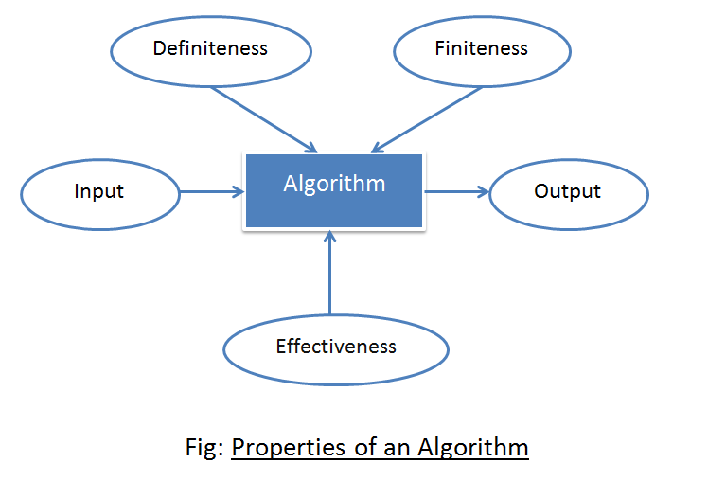
Properties

Slide 7
Properties
Input: An algorithm should have some inputs.
Output: At least one output should be returned by the algorithm based on the given inputs.
Definiteness: Every statement of the algorithm should be clear and unambiguous.
Finiteness: No infinite loop should be allowed in an algorithm.
Effectiveness: Writing an algorithm is a priori process of actual implementation of the algorithm.
So, a person should analyze the algorithm in the finite amount of time with a pen and paper to judge the performance for giving the final version of the algorithm.

Slide 8
while(1<2) { number=number/2; }

Slide 9
Life Cycle
Writing Phase
Testing phase
Design Phase
Analyzing Phase

Slide 10
Design Phase
Some of the techniques used in the design phase
Brute Force Method
Divide-Conquer Method
Greedy Method
Dynamic Programming
Backtracking

Slide 11
Writing Phase
Basically algorithm is written in a modular approach.
Algorithm is written to solve a problem
To make clear every step in the algorithm,
write comments wherever necessary.

Slide 12
Testing Phase
After writing an algorithm, it is necessary to check
that the algorithm gives a correct result
for every valid input.

Slide 13
AnalyzingPhase
After testing an algorithm, it is required to analyze
how much time and space takes the algorithm.
So, it is mainly used to analyze the time complexity and
space complexity of the algorithm.

Slide 14
Algorithm Design
The important aspects - creating an efficient algorithm to solve a problem in an efficient way using minimum time and space.
To solve a problem, different approaches can be followed.
Some of them can be efficient with respect to time consumption, whereas other approaches may be memory efficient.
However, one has to keep in mind that both time consumption and memory usage cannot be optimized simultaneously.
If we require an algorithm to run in lesser time, we have to invest in more memory and if we require an algorithm to run with lesser memory, we need to have more time.

Slide 15
Problem Development Steps
Problem definition
Development of a model
Specification of an Algorithm
Designing an Algorithm
Checking the correctness of an Algorithm
Analysis of an Algorithm
Implementation of an Algorithm
Program testing
Documentation

Slide 16
Characteristics of Algorithm
Algorithms must have a unique name
Algorithms should have explicitly defined set of inputs and outputs
Algorithms are well-ordered with unambiguous operations
Algorithms halt in a finite amount of time.
Algorithms should not run for infinity, i.e., an algorithm must end at some point

Slide 17
Analysis of algorithm
Analysis of algorithm is the process of analyzing the problem-solving capability of the algorithm in terms of the time and the size of memory for storage while implementation.
However, the main concern of analysis of algorithms is the required time or performance.
Generally, we perform the following types of analysis

Slide 18
Worst-case − The maximum number of steps taken on any instance of size .
Best-case − The minimum number of steps taken on any instance of size .
Average case − An average number of steps taken on any instance of size.
Amortized − A sequence of operations applied to the input of size averaged over time.

Slide 19
Asymptotic Notation
The term Asymptote means a line whose distance to a given curve
tends to zero.
An Asymptotic may or may not intersect its associated curve.
There are mainly five types of Asymptotic notations
Big O Notation
Theta Notation
Omega Notation
Little Omega Notation
Little o Notation

Slide 20
Big O Notation
The function f(n)=O(g(n))
if f(n) ≤ c*g(n) for all n, n≥n₀
where c and n₀ are positive constants.
The function g(n) indicates the upper bound of f(n) and so, g(n) should be small as possible for which the statement f(n)=O(g(n)) is true.

Slide 21
Theta Notation
The function f(n)=θ(g(n))
if c1*g(n)≤ f(n)≤ c2*g(n) for all n, n≥n0
where c1, c2 and n0 are positive constants.
The function g(n) is a tight bound of f(n) because g(n) is both upper and lower bound on f(n).

Slide 22
Omega Notation
The function f(n)=Ω(g(n))
if f(n)≥c*g(n) for all n, n≥n0
where c and n0 are positive constants.
The function g(n) is only a lower bound of f(n) and so, g(n) should be as large as possible for which the statement f(n)≥c*g(n) is true.

Slide 23
Omega Notation
The function f(n)=Ω(g(n))
if f(n)≥c*g(n) for all n, n≥n0
where c and n0 are positive constants.
The function g(n) is only a lower bound of f(n) and so, g(n) should be as large as possible for which the statement f(n)≥c*g(n) is true.

Slide 24

Recap

Slide 25
Quiz at end of the class @ 14-07-2021

Slide 26
Thank You

